Slide 1
Electronic Devices
Final Term Lecture - 01
Reference book:
Electronic Devices and Circuit Theory (Chapter-5)
Robert L. Boylestad and L. Nashelsky , (11th Edition)

Slide 2
OBJECTIVES
Become familiar with there , hybrid, and hybrid p models for the BJT transistor.
Learn to use the equivalent model to find the important ac parameters for an amplifier.
Understand the effects of a source resistance and load resistor on the overall gain and characteristics of an amplifier.
Become aware of the general ac characteristics of a variety of important BJT configurations.
Begin to understand the advantages associated with the two-port systems approach to single- and multistage amplifiers.
Develop some skill in troubleshooting ac amplifier networks.

Slide 3
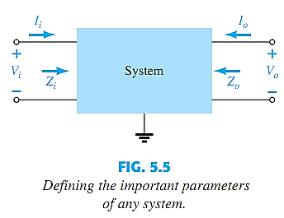
BJT TRANSISTOR MODELING
A model is an equivalent circuit that represents the AC characteristics of the transistor.
A model uses circuit elements that approximate the behavior of the transistor.
There are two models commonly used in small signal AC analysis of a transistor:
r_{e} model
Hybrid equivalent model

Slide 4
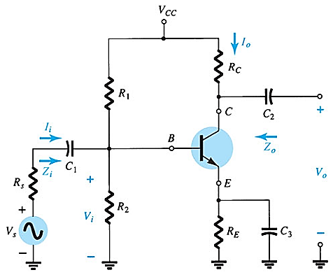
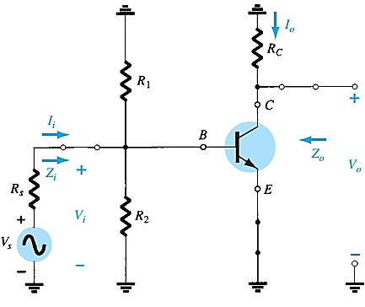
BJT TRANSISTOR MODELING
Capacitors chosen with very small reactance at the frequency of application → replaced by low-resistance or short circuit.
Removal of the dc supply and insertion of the short-circuit equivalent for the capacitors.

Slide 5
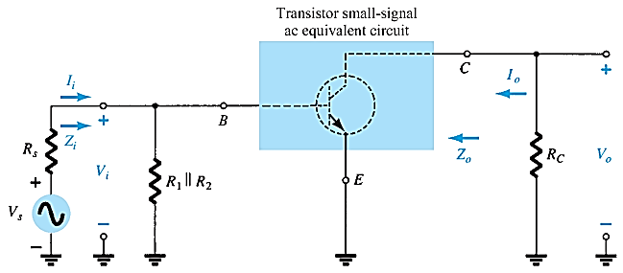
BJT TRANSISTOR MODELING
Circuit redrawn for small signal ac analysis

Slide 6
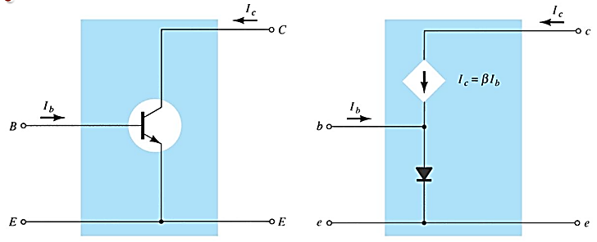
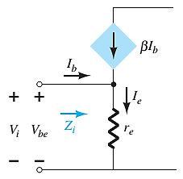
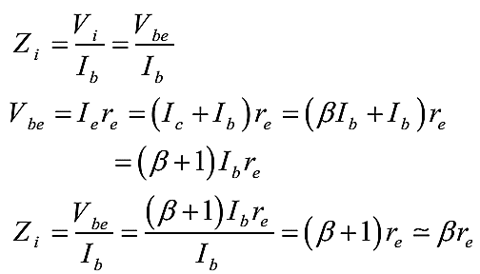
The r_{e} Transistor Model (Common Emitter Configuration)

Slide 7
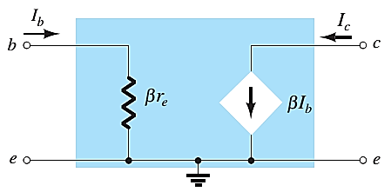

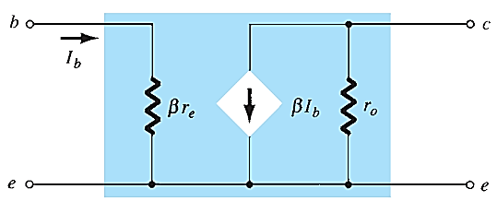
The r_{e} Transistor Model (Common Emitter Configuration)

Slide 8
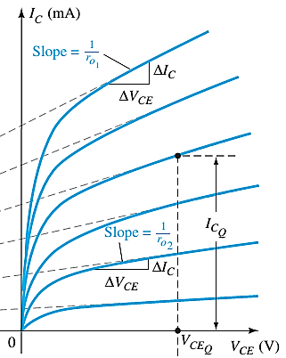


The r_{e} Transistor Model (Common Emitter Configuration)

Slide 9
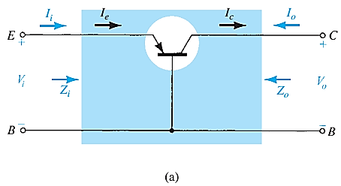
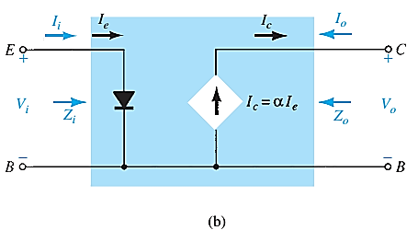
COMMON-BASE CONFIGURATION

Slide 10
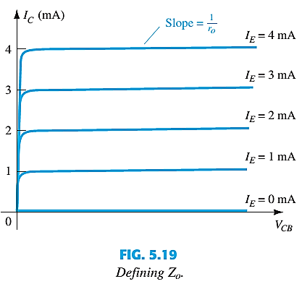
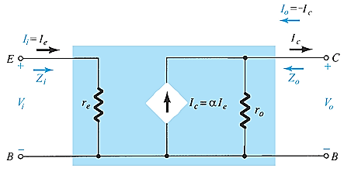
COMMON-BASE CONFIGURATION
The output resistance r₀ is quite high. typically extend into the MΩ range.
Common Base r_{e} equivalent circuit

Slide 11
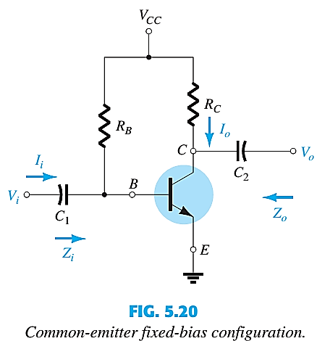
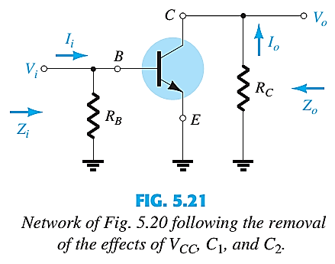
COMMON EMITTER FIXED BIAS CONFIGURATION

Slide 12
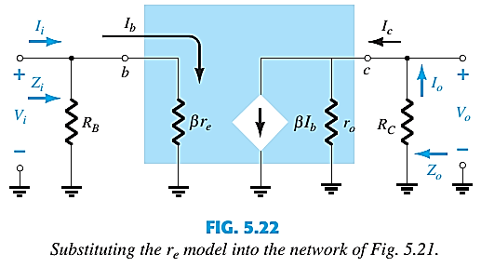
COMMON EMITTER FIXED BIAS CONFIGURATION

Slide 13
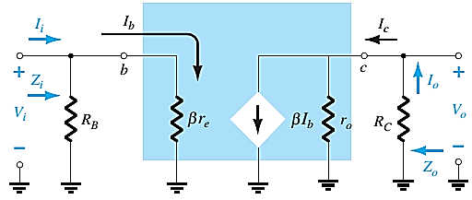







COMMON EMITTER FIXED BIAS CONFIGURATION
INPUT IMPEDANCE, Z_{i}
$Z_{i}= R_{B}‖$ β$r_{e}$
$Z_{i}≅$β$r_{e}$|$R_{B}≥10\text{β}r_{e}$
OUTPUT IMPEDANCE, Z_{o}
VOLTAGE GAIN, A_{v}
$Z_{o}= R_{C}‖$ $r_{o}$
$V_{o}= {−\text{β}I_{b}(R}_{C}‖$ $r_{o})=−\text{β}\text{(}\frac{V_{i}}{\text{β}r_{e}}$)${ (R}_{C}‖$ $r_{o});$
$$I_{b}= \frac{V_{i}}{\text{β}r_{e}}$$
$Z_{o}≅ R_{C}$|$r_{o}≥10R_{C}$
$A_{v}= \frac{V_{o}}{V_{i}}$ = - $\frac{{ (R}_{C}‖ r_{o})}{r_{e}}$, ${ A}_{v}$= - $\frac{{ R}_{C}}{r_{e}} |r_{o}≥10R_{C}$

Slide 14
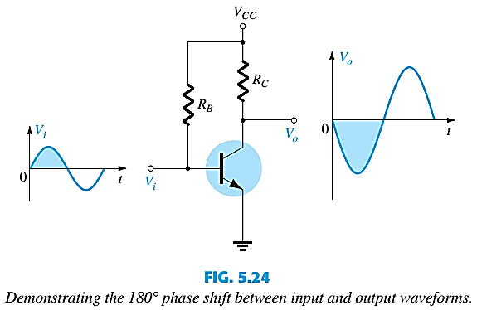
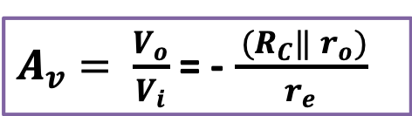
COMMON EMITTER FIXED BIAS PHASE RELATIONSHIP
$A_{v}= \frac{V_{o}}{V_{i}}$ = - $\frac{{ (R}_{C}‖ r_{o})}{r_{e}}$
Demonstrating the 180° phase shift between input and output waveforms.

Slide 15
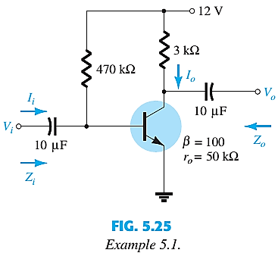
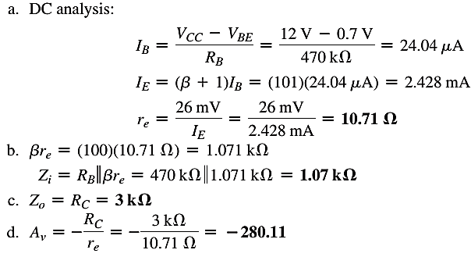

EXAMPLE
EXAMPLE 5.1: For the network of Fig. 5.25 :
Determine r_{e}, Z_{i} (with r_{o} = ∞), Z_{o} (with r_{o} = ∞), A_{v} (with r_{o} = ∞) and Repeat with r_{o} = 50 kΩ.

Slide 16
End of Lecture-1

